Slide 1
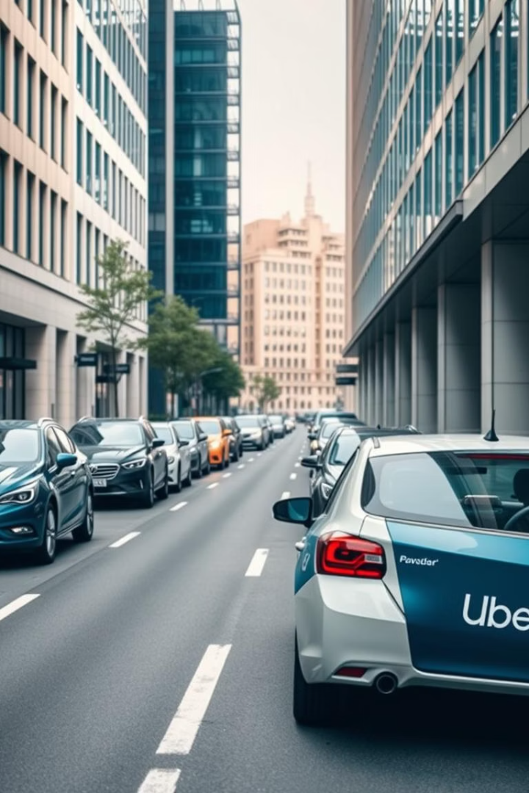


Uber Priority Ride System
Presented by :
Krishna Kumar Bais (241110038)
Rohan (241110057)
Sevak Shekokar (241110065)
CS798H: HUMAN COMPUTER INTERACTION
Department of Computer Science and Engineering
Indian Institute of Technology Kanpur (IITK)

Slide 2

Problem Overview
Frequent Ride Cancellations
Users often experience ride cancellations when heading to hospitals, airports, and railway stations. These cancellations lead to significant disruptions, affecting urgent schedules, and causing stressful delays.
Missed Flights & Trains
Medical Disruptions
Users face consequences due to unreliable rides.
Last-minute cancellations jeopardize timely arrivals for flights and trains, resulting in missed travel and stress.
Critical rides to hospitals are often delayed or canceled.
Cancelled rides to hospitals put patients and families at risk by delaying critical medical appointments and emergencies.

Slide 3
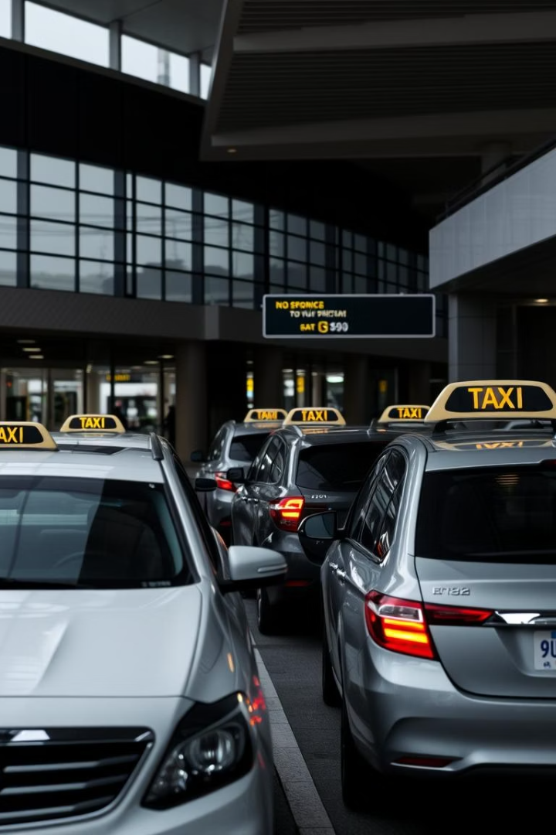

Gaps in the Current System
No Priority Ride Option
No Driver Incentives
Critical destinations lack a dedicated priority feature to ensure reliability.
Drivers lack motivation to prioritize urgent rides, leading to higher cancellations.
Lack of Destination Sensitivity
The system does not differentiate trips based on destination urgency or importance.

Slide 4




Our Goal
Enhance User Trust
Increase user’s confidence in booking rides for urgent or important travel needs.
Improve Ride Reliability
Incentivize Drivers
Ensure rides to critical destinations maintain high commitment and completion rates.
Offer fair compensation to drivers for accepting priority rides.
2
1
3

Slide 5
Needfindings - Survey
Objective:
To understand how users are affected by ride cancellations during critical times.
Methodology:
Conducted a structured Google Form survey that included both closed-ended and open-ended questions targeting regular Uber users.
Total Participants: 88
Participant type: Students, working professionals, Uber users
Key Questions Asked:
Have you ever had a ride canceled while heading to a hospital, airport, or train station?
What were the consequences of the cancellation?

Slide 6
Needfindings - Survey
Key Findings:
45.5% of respondents faced ride cancellations while heading to critical destinations.
Consequences included: missed flights/trains, delayed medical visits, increased stress.
Users were open to paying a small premium for a “guaranteed” ride option.
Insights:
Ride cancellations for urgent trips are not rare.
Users want more control over trip reliability.
There is strong acceptance for a “Priority Ride” feature, provided it is optional and transparent.

Slide 7
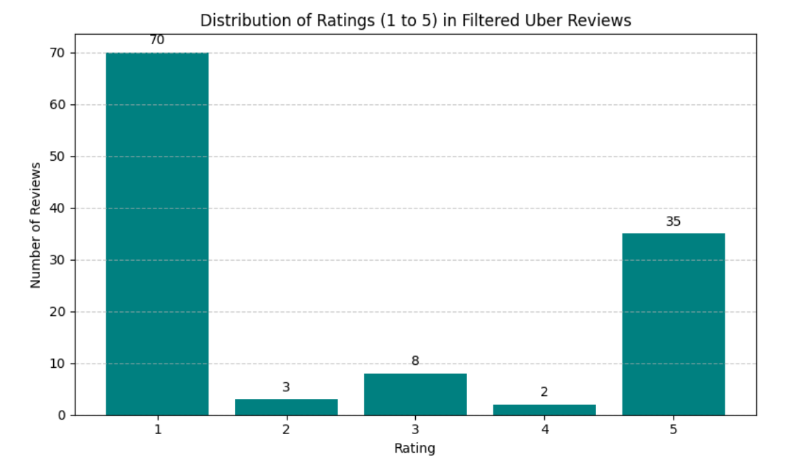
Needfinding – Kaggle Review Dataset
Objective: To validate our survey findings, we analyzed large-scale Uber app reviews to check if users were reporting similar issues.
Data Source: Kaggle dataset – Uber App Reviews (2024) Filter Criteria: Keywords = "hospital", "airport", "railway", "train station", "emergency"
Filtered Reviews : 118 relevant reviews

Slide 8
Needfinding – Kaggle Review Dataset
Themes Identified:
Frequent Last-Minute Cancellations: Users often faced cancellations when rushing to airports or medical appointments.
Missed Flights & Appointments: Many users reported that cancellations led to significant life disruptions.
Emotional Tone: Words like "bad experience", “panic”, "frustration", and "unreliable" were common.
Insights:
Strong alignment with survey findings : ride cancellations are a systemic issue.
Emotional and logistical consequences highlight the need for a reliable priority system.
Review comments confirmed that users want a system that considers trip urgency.

Slide 9
Needfinding After Triangulation
Objective: To synthesize insights from both the User Survey and the Kaggle Filtered Review Data to identify consistent, validated user pain points and needs.
Common Findings Across Both Sources:
Frequent cancellations to critical destinations were a recurring issue, mentioned in both structured responses and open reviews.
Emotional and practical consequences (missed appointments, anxiety, urgency) appeared across survey responses and review sentiments.
Lack of a priority feature was implicitly and explicitly highlighted as a design gap.
User willingness to pay more for a reliable service was a shared trend in survey data and inferred from complaints about unreliability in reviews.

Slide 10
Needfinding After By Triangulation
Validated Themes:
Unreliable for Emergencies: Uber is not currently seen as dependable for time-sensitive trips.
Trust Deficit: Users lack confidence that rides will be honored for high-stakes destinations.
User Demand for Control: Both sources show users want more influence over reliability — ideally via an optional feature.
Conclusion: The overlap between survey feedback and reviews complaints confirms a strong, unmet need:
A user-controlled, driver-informed Priority Ride feature that improves reliability without disrupting standard usage.

Slide 11

Assumptions
Users clearly understand what qualifies as a “critical destination.”
Drivers are willing to accept additional restrictions if compensated fairly.
Keyword-based detection is sufficient for identifying most priority trips.
Front-end simulation is enough to test user behavior and concept validation.
Driver with only high ratings and experience will be assigned as a priority rider in the database.
User and driver are familiar with english.
Driver have knowledge about what is priority ride and cancellation policy.

Slide 12

Our Solution
Priority Ride Feature
Extra Cost Option
Automatically detects critical destinations like hospitals, airports, and railway stations.
Users can opt-in for a priority ride with a small additional fee to ensure reliability.
Critical Destination Detection
System recognizes priority locations to trigger appropriate driver and motivate them.

Slide 13

Key Design Decisions
User Interface
Driver Interface
Automatic Detection of critical destination
Simple opt-in priority prompt
Priority rides are assigned to nearby verified drivers
Transparency in increased fare
Exclusive priority badge for identification
25% higher fares for priority rides
No Cancellation to ensure reliability
Dedicated emergency reporting feature

Slide 14
Prototype Clarification
Focus:
Designed to test core Priority Ride System features (critical destination detection, priority popup, cancellation penalties).
Limitations:
No backend integration (e.g., live maps, fare calculations, geolocation).
No real-time data (e.g., driver tracking, ride confirmation).
Non-core Uber features (e.g., rebooking, payment gateways) are static/visual placeholders.
Visual Fidelity:
Non-functional buttons (e.g., "Rebook Ride" ,"menus", "maps") retain styling but lack backend logic.
Map Behavior:
For destination and location suggestions, we used an open-source API, not Google Maps.
This means - Location predictions may not cover all areas or Point of Interests (POIs) like Google Maps and The map layout and route suggestions are basic and focused on UI flow demonstration.
Non-functional buttons (e.g., "Rebook Ride") retain styling but lack backend logic.

Slide 15
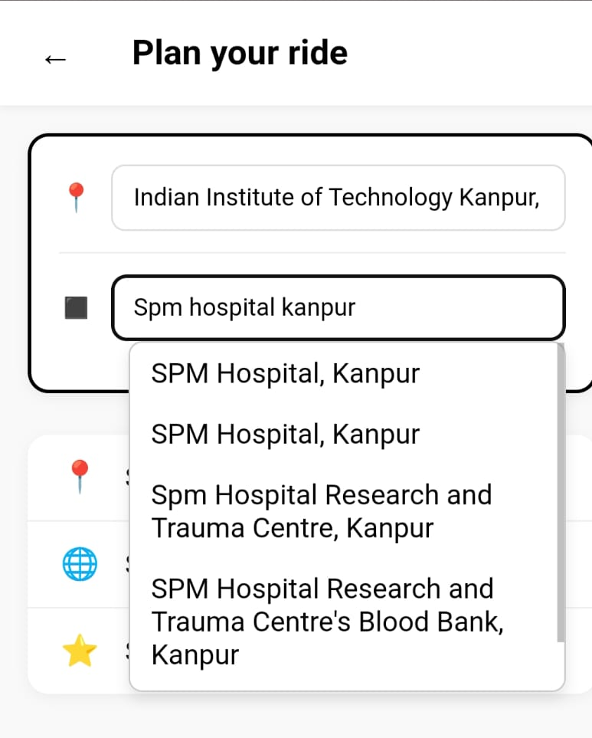
Implementation Details for User
Feature 1: Critical Destination Detection
What’s Implemented
Automatically detects if the user’s drop location is critical (e.g., hospitals, airports, railway stations).
Implemented using a predefined list of keywords:
const criticalKeywords = ["hospital", "station", "railway", "emergency", "clinic", "medical",
"airport", "health center"];
Logic is lightweight and runs entirely on the client-side.
Designed to work without geolocation APIs or backend lookups.
This aligns with core usability heuristics:
Recognition rather than recall No manual tagging of locations needed by the user.
Efficiency of use Automatically adapts flow based on context (e.g., urgency).
Flexibility and simplicity Supports natural, typed location names with basic keyword matching.

Slide 16

Implementation Details for User
Feature 2: Priority Ride Popup
What’s Implemented
When a critical destination is detected, a priority ride confirmation popup is triggered.
The pop-up clearly displays important terms:
25% higher fare.
No refund (100% cancellation penalty).
Driver cannot cancel once confirmed.
Users must explicitly confirm or reject prioritizing the ride: Fare prices for all ride options are updated in real-time based on priority selection.
Fully client-side implementation using HTML, CSS, and JavaScript.
UI remains responsive and works on mobile and desktop screens.
This aligns with core usability heuristics:
User control and freedom Users have the choice to accept or decline priority rides.
Visibility of system status Transparency in increased fare and penalty terms are clearly shown.
Error prevention Prevents accidental confirmation with a forced modal confirmation step.

Slide 17
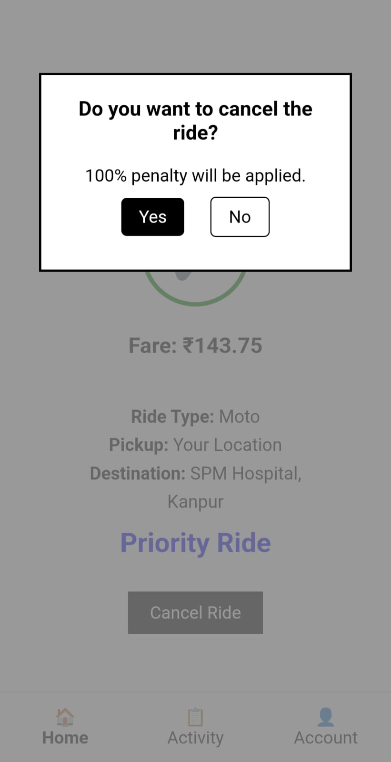
Implementation Details for User
Feature 3: Priority Ride Cancellation Penalty
What’s Implemented
Detects if a ride is priority based on fare comparison.
Shows a confirmation popup on cancel attempt.
Displays 100% penalty warning for priority rides.
Implemented fully on the client-side using JavaScript.
Works on all devices with responsive design.
Usability Heuristics
Error prevention – Warns before irreversible action.
User control – Lets users cancel or go back.
Visibility – Clearly shows priority status and penalty.

Slide 18

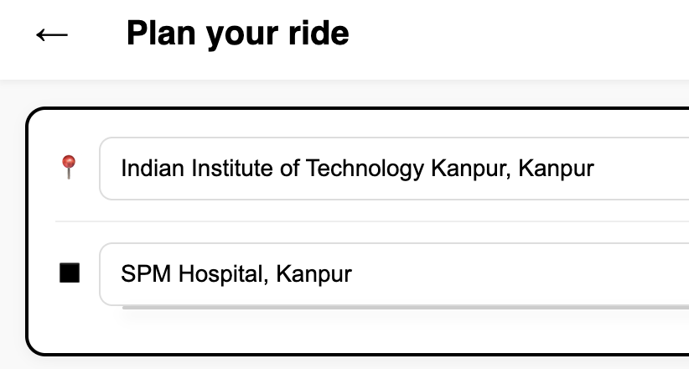


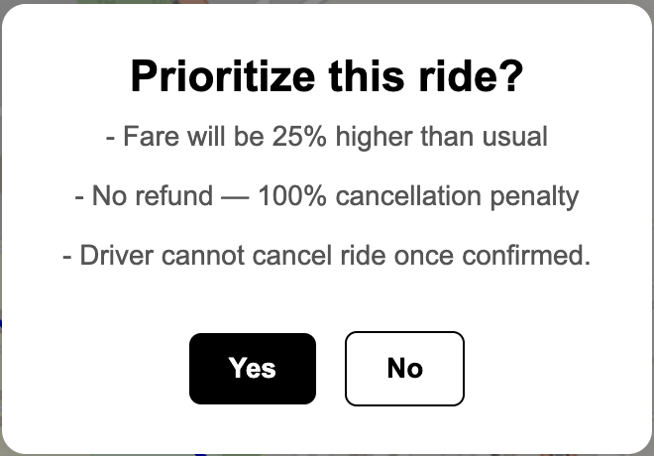


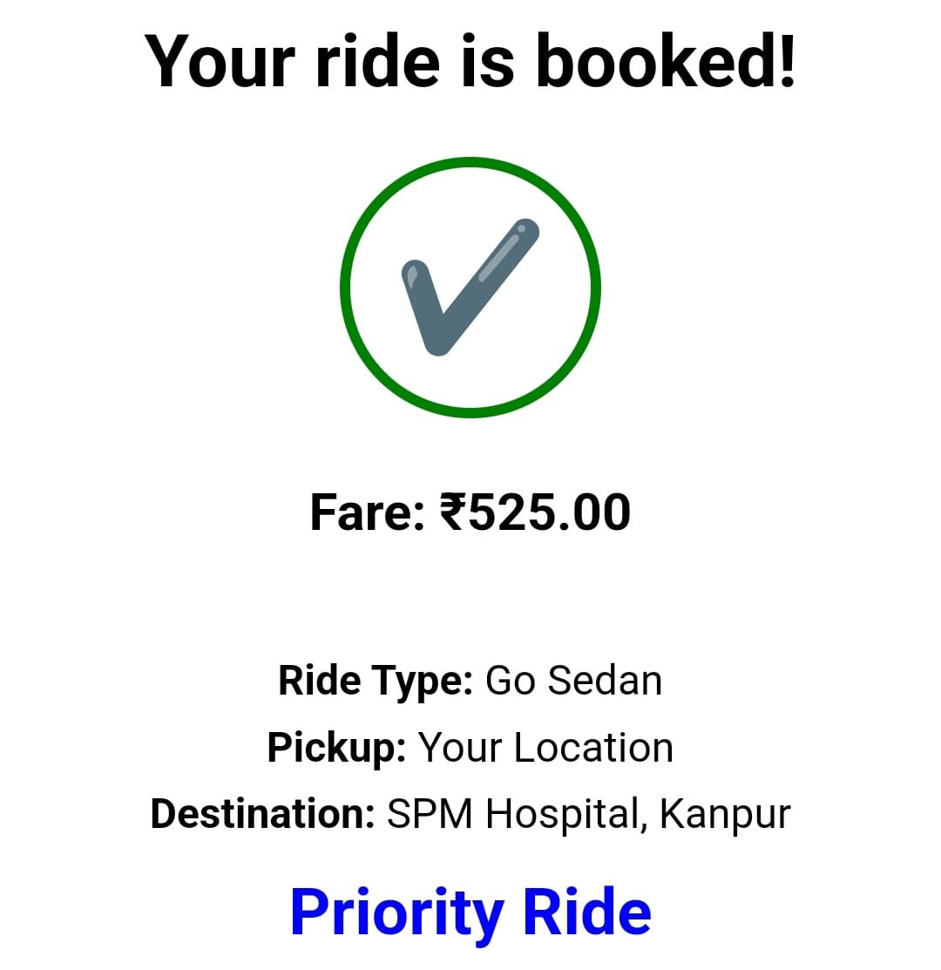
User Flow
Enter Destination
User inputs intended location into app interface.
Priority Prompt
App detects critical location and prompts user to select priority ride option.
Confirm Ride
User confirms ride booking with optional extra priority fee applied.

Slide 19
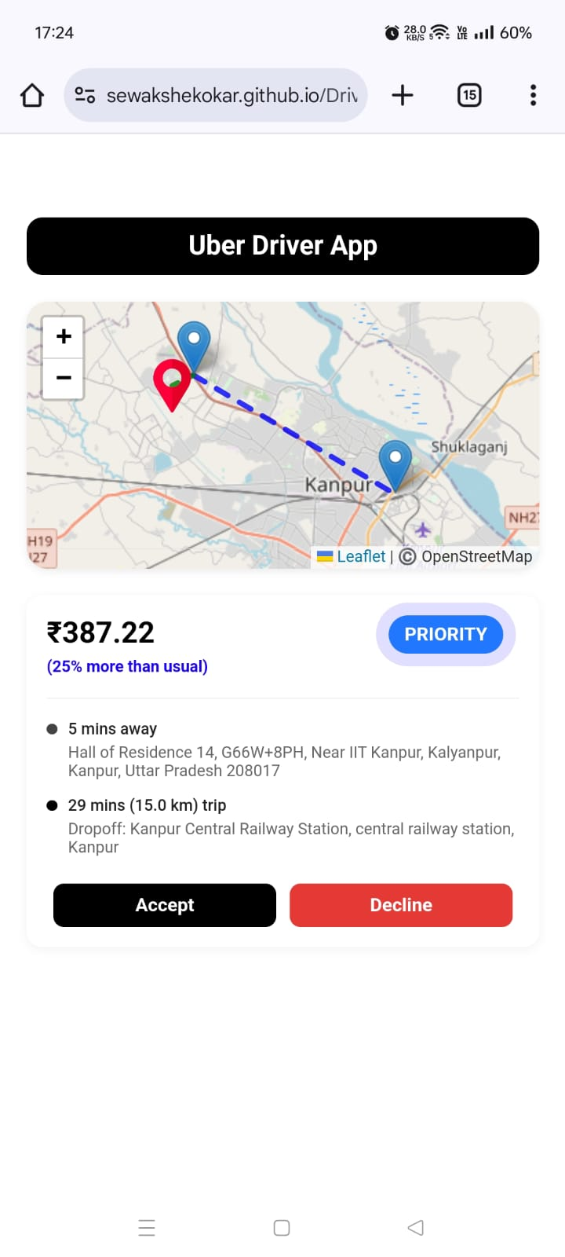
Implementation Details for Driver
Feature 1: Dynamic Fare Adjustment
What’s Implemented
Priority rides show a 25% higher fare than usual.
Fare difference is clearly stated below the tag.
Emphasizes financial incentive to accept priority rides.
Usability Heuristics
Visibility of system status (users see price adjustment instantly)
Match between system and real world (familiar pricing logic)

Slide 20
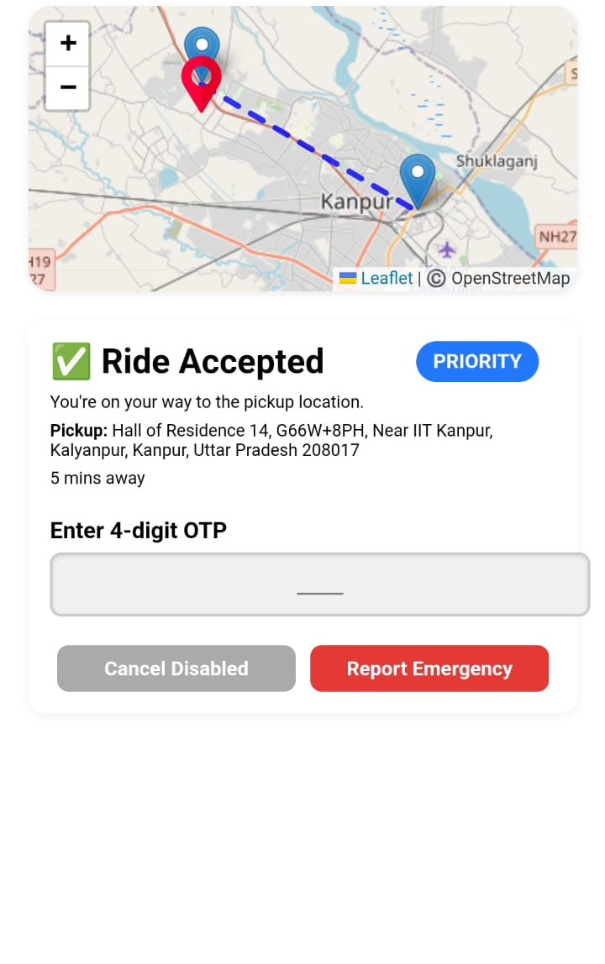
Implementation Details for Driver
Feature 2: Priority Ride Tag Display
What’s Implemented
A distinct “PRIORITY” badge is shown for high-priority ride requests.
Badge is styled with a blue color and animated for emphasis.
Helps drivers visually differentiate priority ride requests.
Clearly positioned beside fare details for visibility.
Usability Heuristics
Visibility of system status (prominent tag shows priority)
Recognition rather than recall (no need to infer ride type)

Slide 21
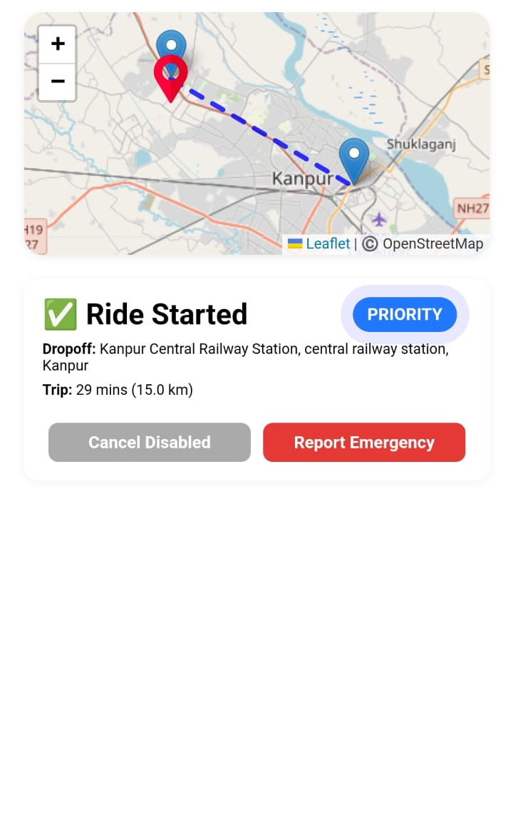
Implementation Details for Driver
Feature 3: Disabled Cancel Button for Priority
What’s Implemented
Cancel option is disabled for accepted priority rides.
Prevents misuse and ensures commitment to critical rides.
UI reflects this state with a grayed-out, non-interactive button.
Usability Heuristics
Error prevention (blocks unintended cancellations)
User control (button visually communicates restriction)

Slide 22
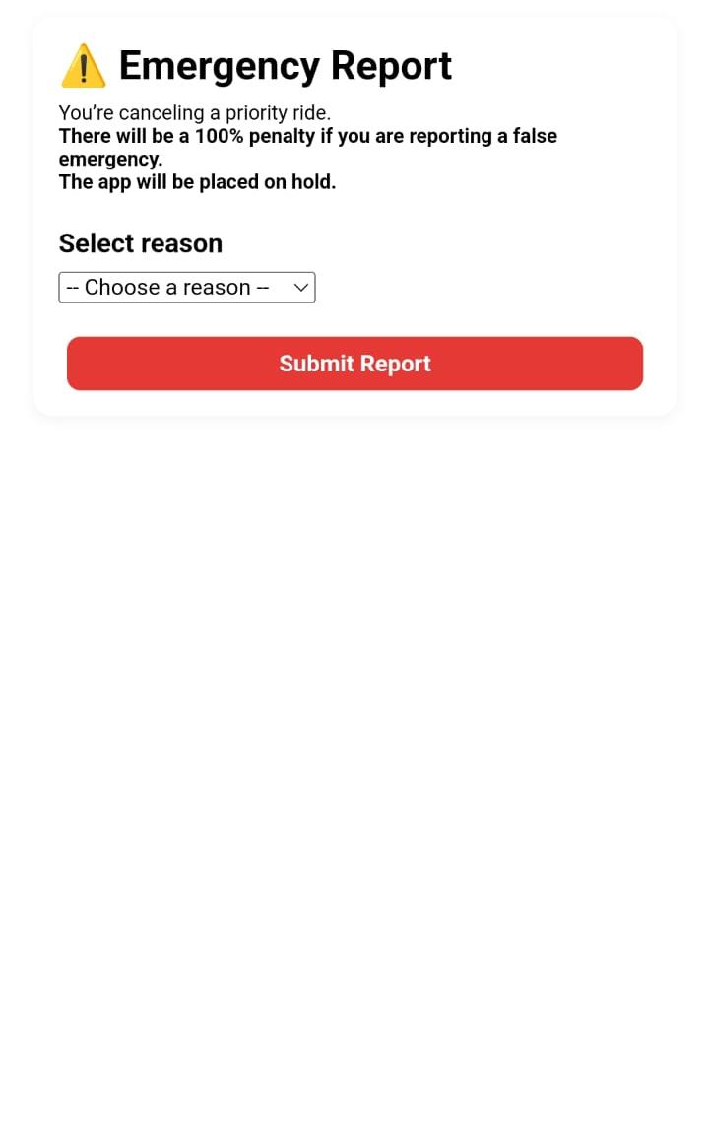
Implementation Details for Driver
Feature 4: Emergency Reporting Option
What’s Implemented
Button to report emergency is shown during priority rides.
Drivers can select reason: “🚗 Vehicle Breakdown” or “🤒 Health Issue”.
Offers responsible exit in real emergencies.
Usability Heuristics
Flexibility and efficiency of use (direct action in emergencies)

Slide 23
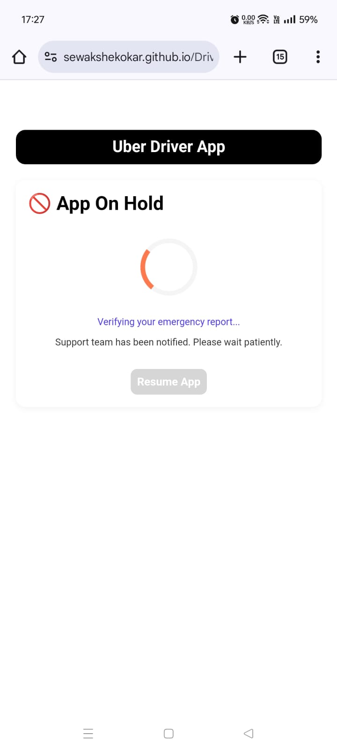
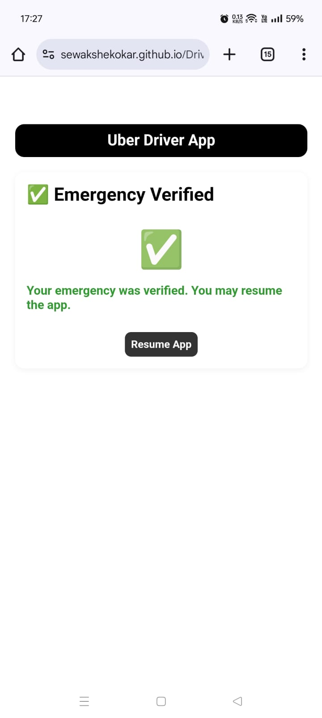
Implementation Details for Driver
Feature 5: App On Hold After Emergency Reported
What’s Implemented
After reporting an emergency, app enters a “Hold” state.
Spinner animation and a verification message are shown.
“Resume App” button is disabled until verification completes.
Visual feedback includes a ✅ tick once verified.
Usability Heuristics
Visibility of system status (spinner, status message, and verified tick)

Slide 24

Driver Flow
1
Priority Tag
2
Higher Fare
Drivers see clear tagging on priority rides to identify their importance and avoid cancellations.
Increased compensation reflects the critical nature and commitment required for these trips.
3
Cancellation Limits
Cancellation is restricted except in documented emergencies, promoting ride reliability.

Slide 25
Evaluation Methodology
1. Evaluation Approach
● Hybrid Method : Combined task-based usability testing along with post-test surveys to assess both feature performance and overall usability.
● Focus Areas: Prioritized testing for critical destination detection, priority ride flow, and cancellation penalties, priority ride identification by driver.
2. Think-Aloud Protocol
● Participants verbalized thoughts during tasks.
● Participants probed for clarity on.
3. Participant Recruitment (selected via convenience sampling)
● User Testing : N=19 participants.
● Driver Testing : N=9 participants.
4. Test Setup
● Duration: ~3–5 minutes per session (user + driver tests).
● Roles:
Participants : Guided tasks and asked follow-up questions.
Observer: Documented behavioral cues.
● Environment : Conducted in a quiet lab setting with voice recording (consent obtained).

Slide 26
User Evaluation (User Interface)
Time Spent:
Fastest: 40 sec (experienced user in a hurry).
Slowest: 180 sec (confusion in priority selection).
Common Confusions:
Misdetection of critical destinations (e.g., "Kanpur Central" not flagged as a railway station).
Users appreciated auto-detection but faced issues with keyword mismatches (e.g., "health center" detected, but "AIIMS" missed).
Users tapped non-functional icons (e.g., placeholder buttons).
Uncertainty about cancellation penalties (e.g., "Did not see 100% penalty warning").
What if the driver cancel the ride?
Mistakes:
Typing errors in auto-filled addresses.
Popup timing was praised, but some users missed penalty details.
Accidentally entering destinations in the wrong field (e.g., "wrote destination in pickup location").

Slide 27
User Feedback & Suggestions (User Interface)
SUS Score: Average 86.45 (indicating good usability, with room for refinement).
Notable Suggestions
UI Improvements:
Increase text size for readability.
Improve navigation flow between screens.
Future Enhancements:
Add more institutions (e.g., AIIMS) to critical destination keywords.
Clarity Requests:
Explain what happens if a driver cancels a priority ride.
Highlight penalty warnings in bold/red text.
Alignment with Usability Heuristics
Recognition Over Recall: Users praised auto-detection but requested better keyword coverage.
Error Prevention: Penalty warnings need stronger visuals.

Slide 28
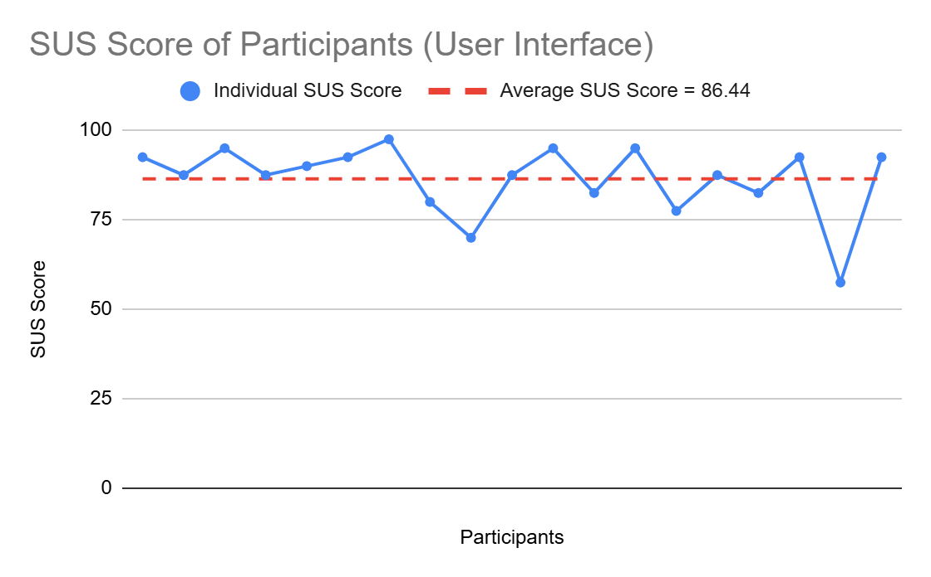
SUS Score for User Interface
The Average SUS Score is 86.44
This is good SUS Score
The lowest score is 57.5
The highest score is 97.5

Slide 29
User Evaluation (Driver Interface):
Time Spent:
Fastest: 70 sec and Slowest: 156 sec
Common Confusions:
Misleading location updates (e.g., "Driver location still shows initial pickup point after ride confirmation").
Accidental taps on priority tags (e.g., "He tapped the priority tag to accept the ride").
UI Feedback:
Requests to clarify when fare incentives apply (e.g., "Add note about 25% higher fare upfront").
Suggestion to fix real-time location tracking during rides.
Priority Ride Tag:
Most users noticed the tag immediately
Disabled Cancel Button:
Users clearly understood the grayed-out cancelled button.
Emergency Reporting:
Most users felt reassured by the option.
No issues locating the emergency button.

Slide 30
User Feedback & Suggestions (Driver Interface)
SUS Score: Average 93.06 (excellent usability).
Notable Suggestions
UI Improvements:
Show drop location only after the ride is started.
Fix driver location updates during rides to reflect real-time movement.
Add a note explaining the 25% fare boost next to the priority tag.
Future Enhancements:
Differentiate destination priority: hospital > railway station, airport based on urgency level.
Clarity Requests:
Clarify how long the app stays in ‘Hold’ state after emergencies.
Simplify verification steps post-emergency reporting.
Alignment with Usability Heuristics
Visibility of System Status: Drivers praised the priority tag but requested clearer fare explanations.
Feedback: Drivers appreciated the app’s "Hold" state but wanted faster verification.

Slide 31
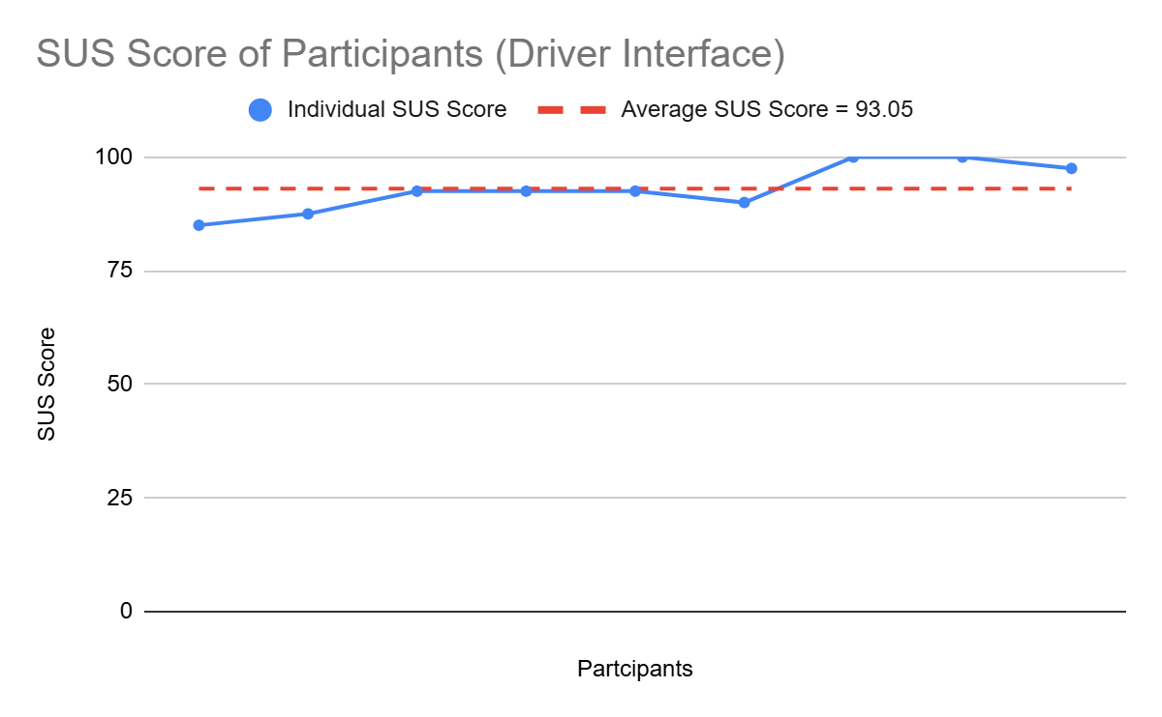
SUS Score for Driver Interface
The Average SUS Score is 93.05
This is good SUS Score.
The lowest score is 85
The highest score is 100

Slide 32
Individual Contribution - Krishna Kumar Bais
Primary Leadership: Research & Data-Driven Insights
Spearheaded user research (survey design, Kaggle review analysis) to quantify cancellation pain points.
Led needfinding synthesis, transforming raw data into actionable requirements (e.g., "Priority Ride" opt-in feature).
Ensured team decisions were grounded in evidence (e.g., 45.5% cancellation rate for critical trips).
Team Collaboration Examples:
Coordinated with Rohan to align driver incentives with survey findings.
Supported Sevak by providing keyword lists ("hospital," "airport") for prototype logic.

Slide 33
Individual Contribution
Individual Contribution - Rohan
Primary Leadership: Driver App UX & Evaluation
Owned the driver-side experience, designing:
Priority Ride tags (+25% fare display) and restricted cancellation (emergency-only).
SUS testing framework, achieving a 93.05 avg. score through iterative refinements.
Bridged user needs (from Krishna’s research) with technical feasibility (Sevak’s implementation).
Team Collaboration Examples:
Worked with Sevak to ensure UI consistency between user/driver apps.
Partnered with Krishna to validate driver incentives via survey quotes.

Slide 34
Individual Contribution - Sevak Shekokar
Primary Leadership: User App Prototyping and deployment.
Built the functional user app , including:
Auto-detection of critical destinations (keyword logic).
Priority Ride popup with dynamic pricing/penalties.
Solved technical hurdles (e.g., open-source map API integration).
Team Collaboration Examples:
Implemented Rohan’s UI designs for seamless user flows.
Used Krishna’s research to prioritize high-impact features (e.g., penalty warnings).

Slide 35
Links to all resources
For Needfinding :
Google Form = Link
Google Form Survey Response Sheet = Link
Original Kaggle Data = Link
Kaggle Data Filtering Code = Link
Kaggle Filtered Data = Link
For User :
GitHub = Link
Interface App = Link
Interview Audio Recordings = Link
Usability Test - Observations = Link
App System Usability Scale (SUS) Survey Google Form = Link
Google Form Response Sheet = Link
For Driver :
GitHub = Link
Interface App = Link
Interview Audio Recordings = Link
Usability Test - Observations = Link
App System Usability Scale (SUS) Survey Google Form = Link
Google Form Response Sheet = Link

Slide 36


